Slide 2
The Challenge
Lack of unique venue space downtown
Underexposure and underutilization of Southbank, Riverwalk & St. Johns River
Lack & underperformance of waterfront bar, retail and entertainment venues
The potential timelines for The Shipyards, Liberty Street, Landing & Healthy Town projects

Slide 3
What’s Missing?
A CREATIVE & VERSATILE ECONOMIC DRIVER THAT:
Creates a unique identity for Jacksonville
Provides sustainable growth
Showcases the river
Drives local/regional energy & excitement
Delivers the community something it is hungry for

Slide 4
The Solution
The BARGE
The region's first ever floating place-making space designed as an entertainment & rental venue
_______________________
-Easy to remove within less than 24 hours-
-Environmentally safe with no hinderance to ecology-
-No encumbering of river and riverwalk access-
-No hinderance to existing business operation-

Slide 5
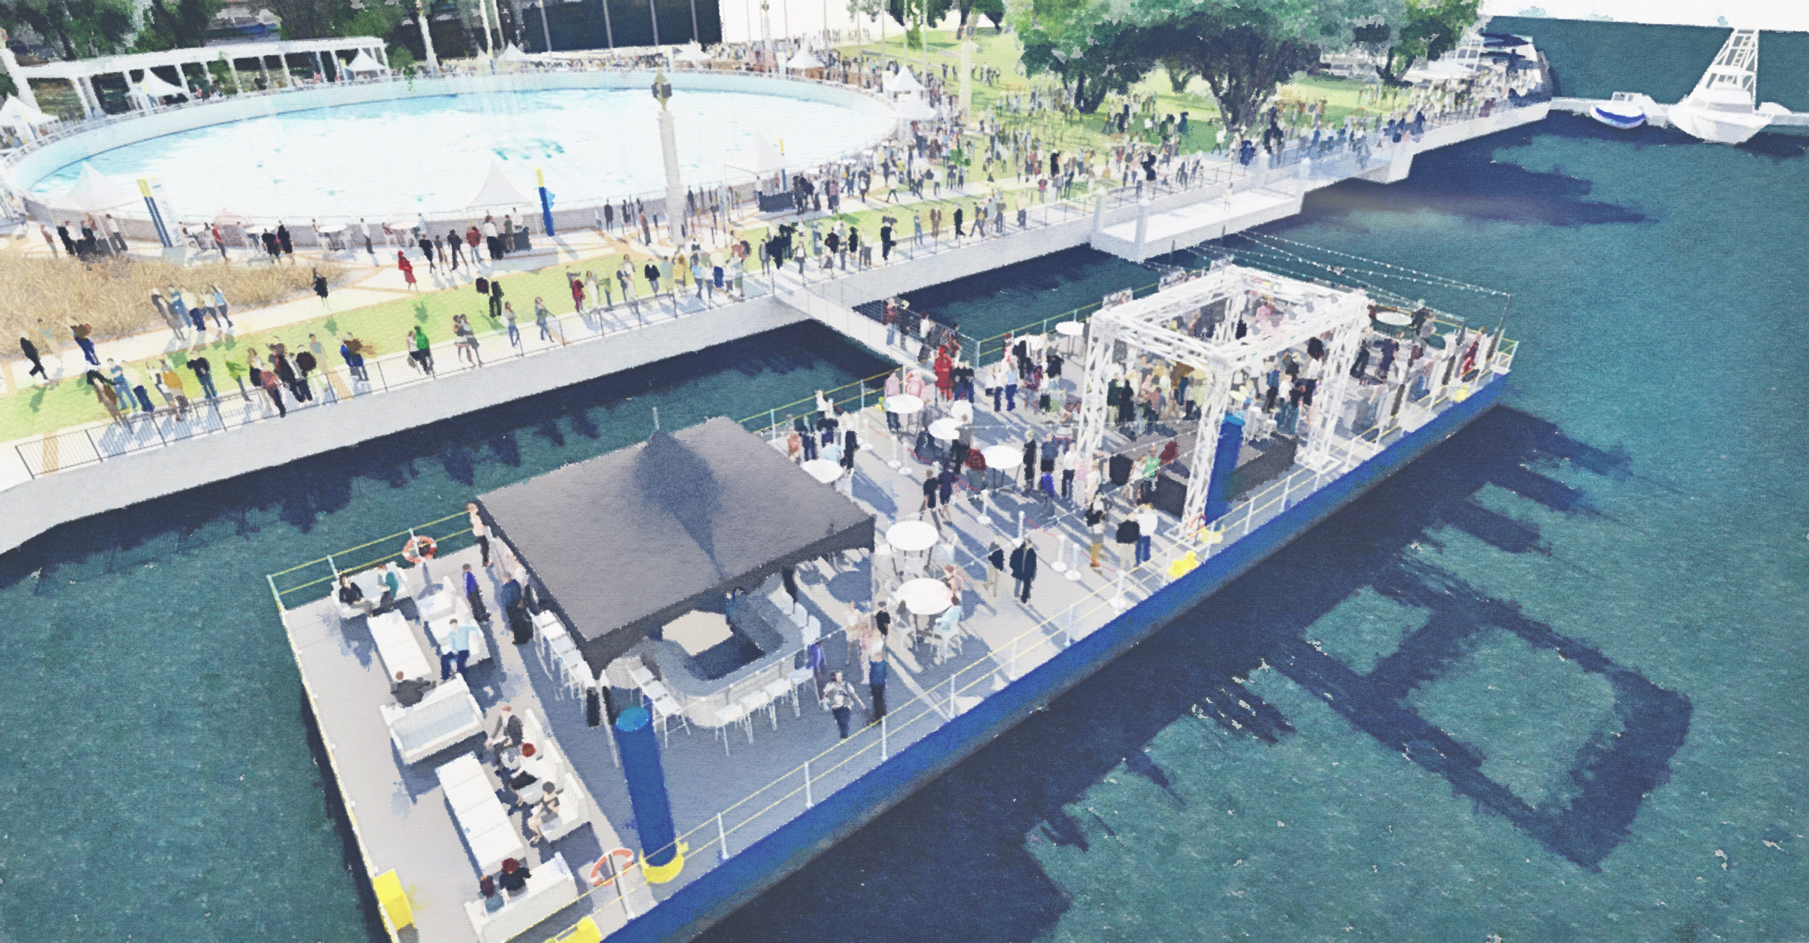
The Solution
Phase 1
A 5000-6000 sq. ft. barge retrofitted and secured for activation at Friendship Park

Slide 6
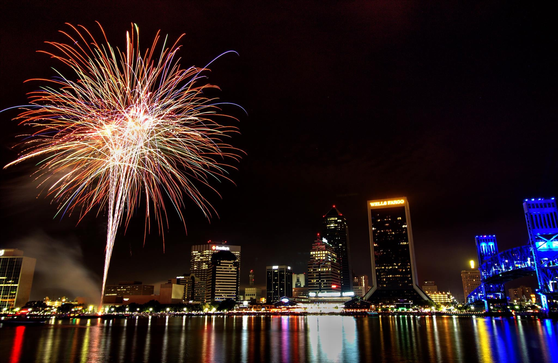
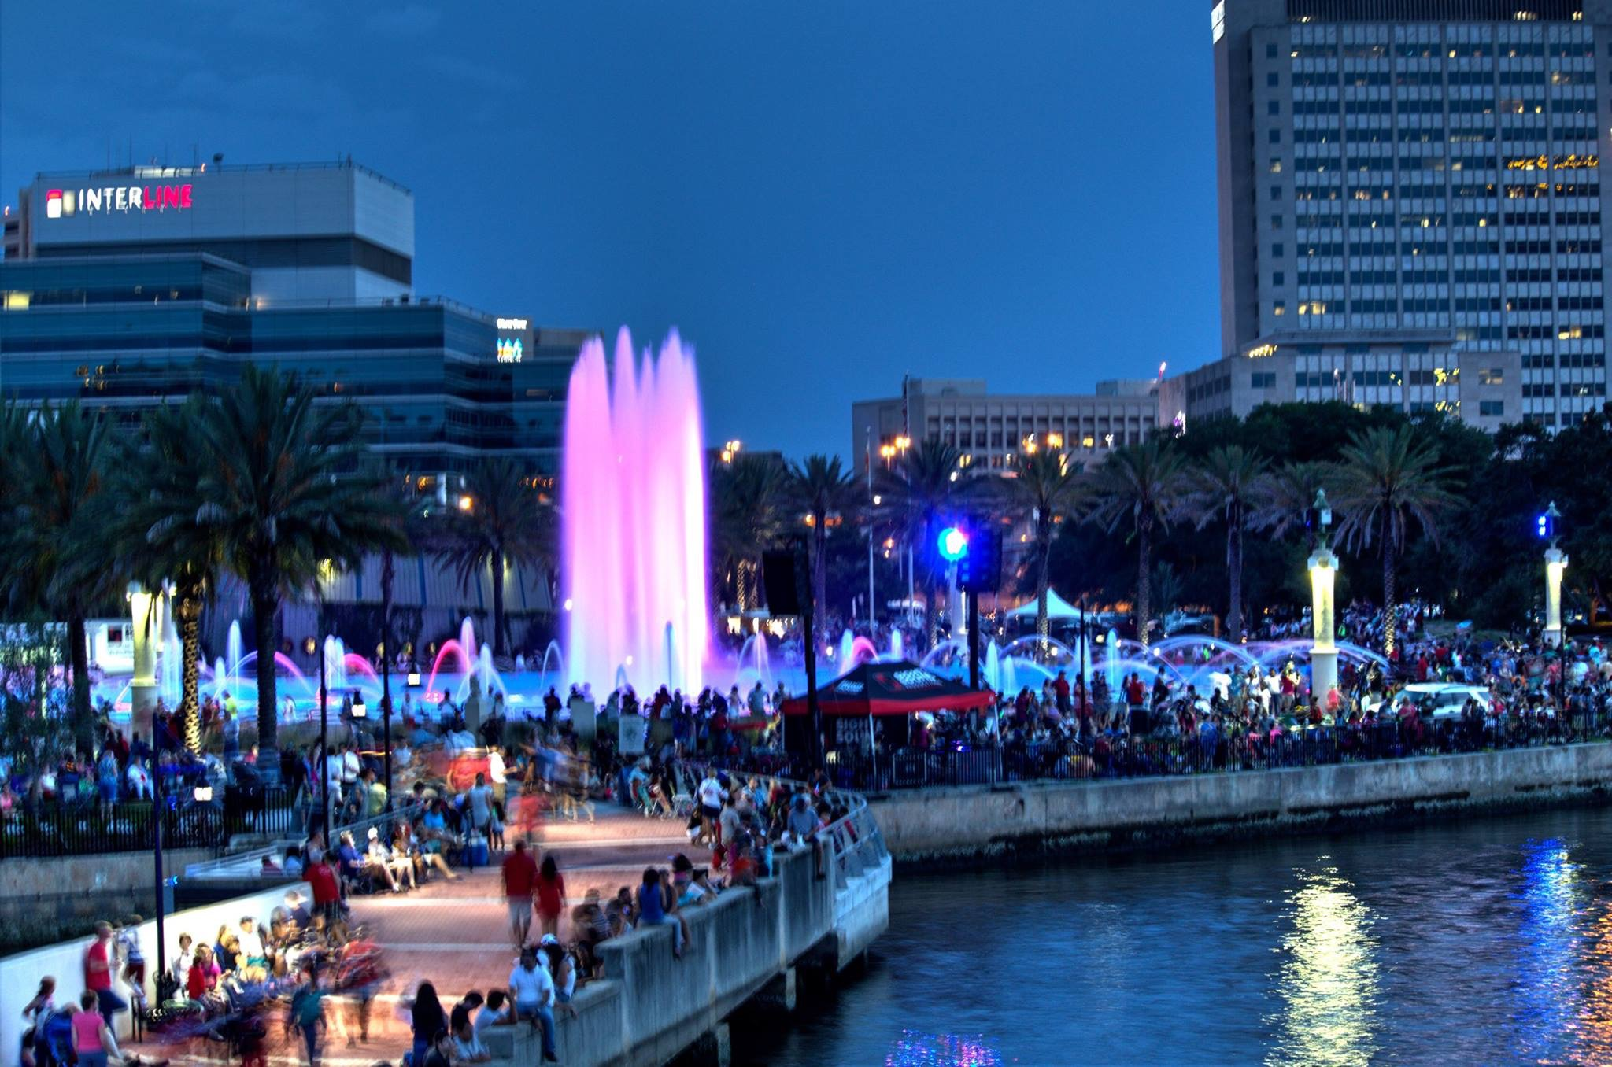
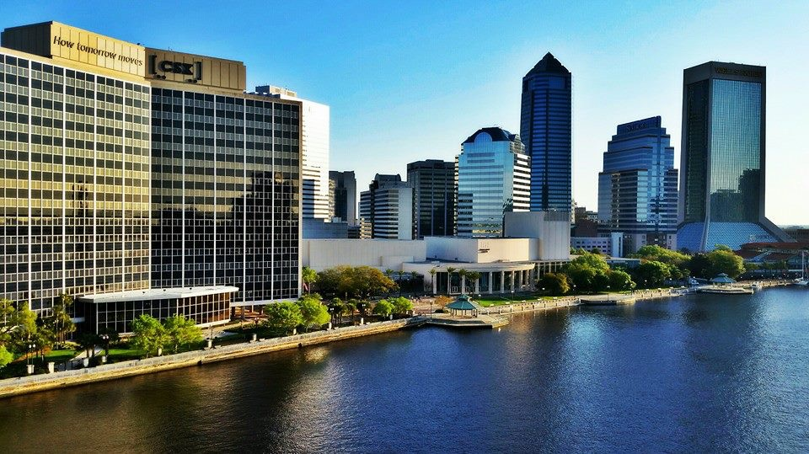
Imagine…

Slide 7
Venue Activation
Corporate events & conference meetings
Private events (weddings, bar mitzvahs, etc)
Community/city events
Sponsored retail activation
Charitable events & activities
Extension of existing venues
MOSH, Florida Theatre, TU Center
Hyatt, Omni, Crowne Plaza, RAM

Slide 8
Impact
New visitors to the Southbank
restaurants, museum, hotels
Connections from the Northbank
water taxi, jaguars games, boaters
Activation of Friendship Park
holidays, concerts, special events
2016 Rentals (Apr-Dec)
est. local economic spend: $575K
2017 Rentals (Jan-Dec)
est. local economic spend: $1.4M
2018 Rentals (Jan-Dec)
est. local economic spend: $1.6M

Slide 9
Traction - Since February 2015
730 Facebook Friends
175 Barge members
37 direct rental inquiries
Over 200 requests for more information
612 Twitter Followers
Daily interest and questions on our launch date
12 media hits
More than a dozen Barge inquiries through Visit Jacksonville from out of town planners

Slide 10
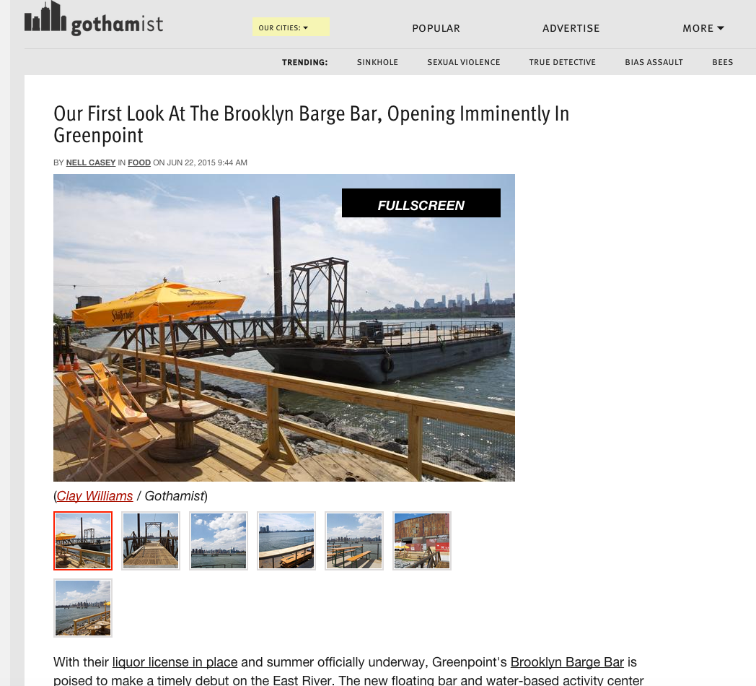
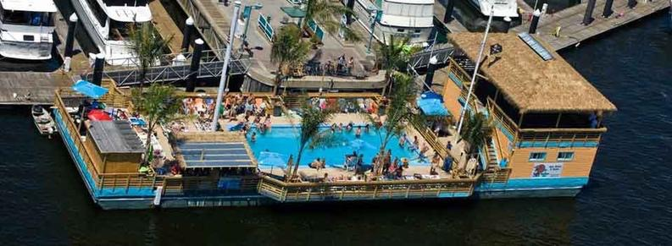
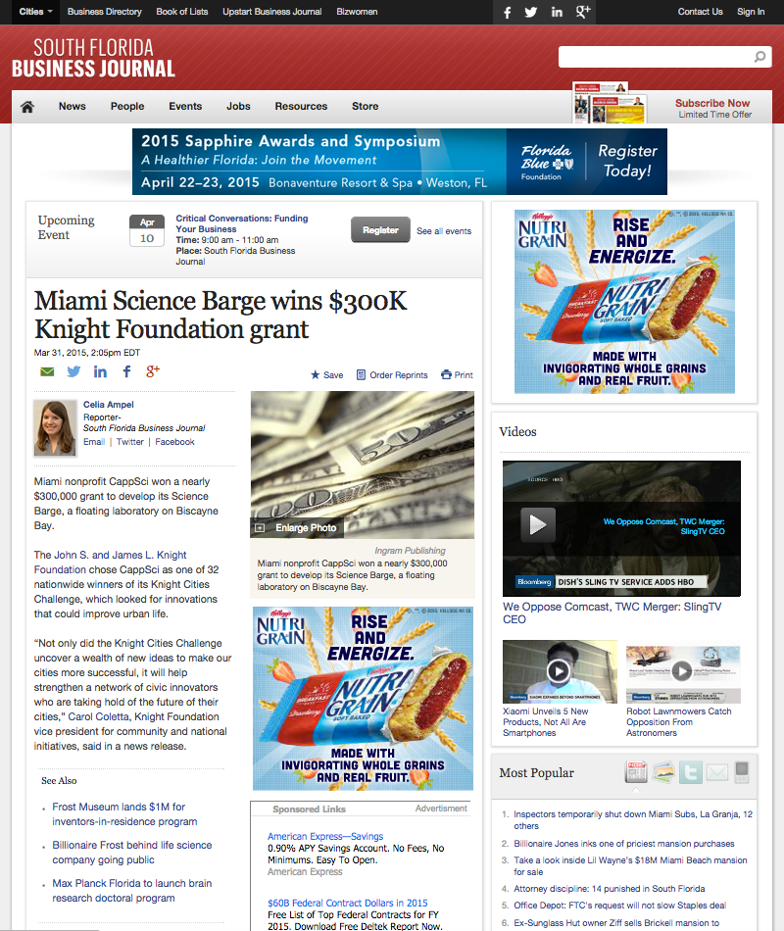
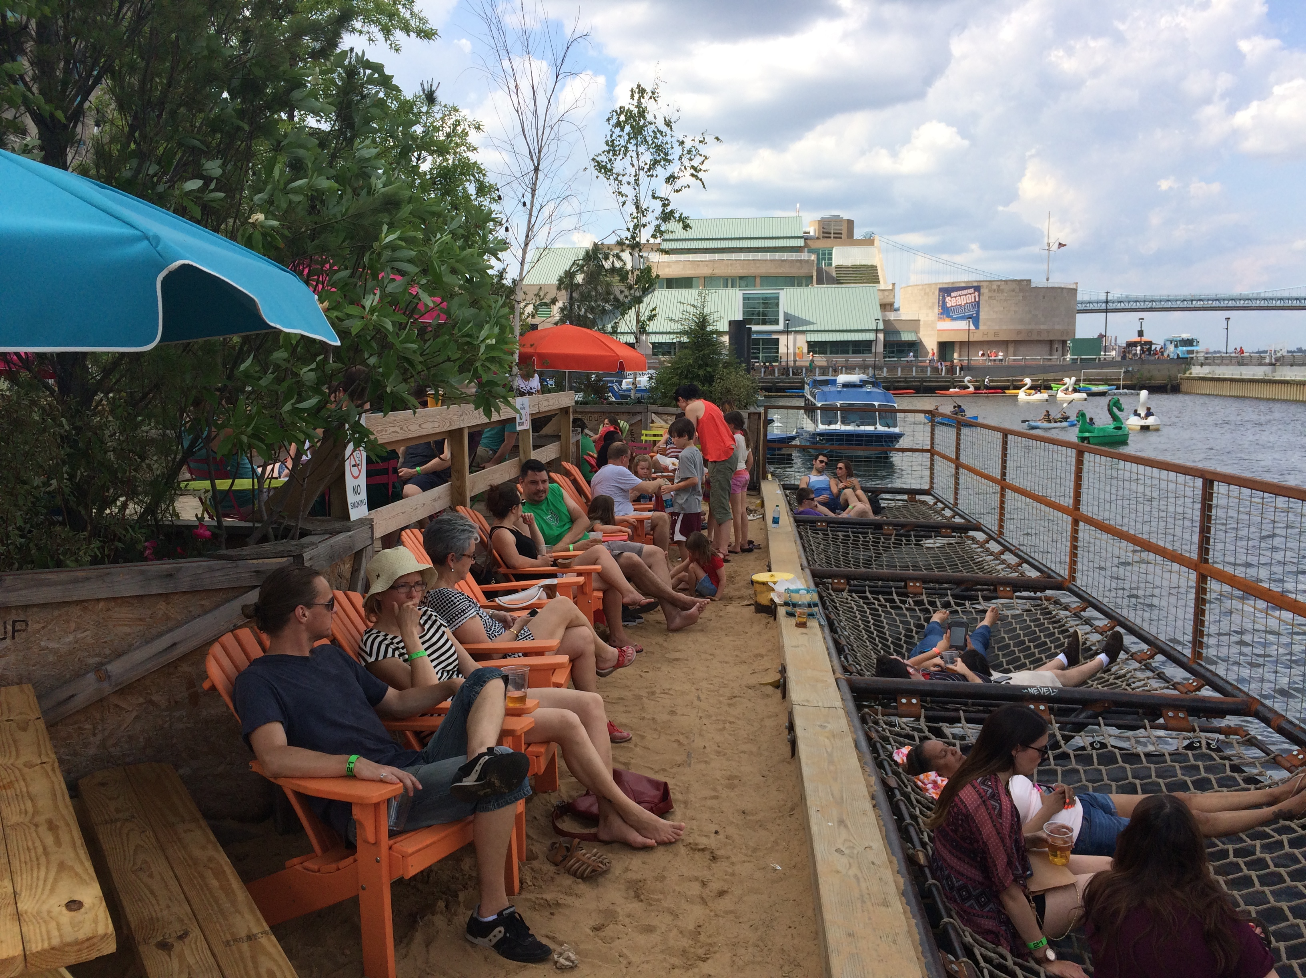
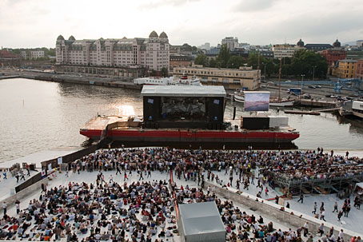
Precedent

Slide 11
Vision
Create and build a “Barge Economy” on the water utilizing barges as event venues and retail establishments in a creative, entrepreneurial and environmentally responsible way
Begin in downtown Jacksonville
Expand into the region connecting land to water
Develop new industry
Create new jobs

Slide 12
The Plan
Phase 1: 72 Hour Rentals
Nov 2015 - March 2016 - Friendship Park, Locations TBD
Phase 1A: “Permanent” Rentals
April - Dec 2016 - Friendship Park

Slide 13
What We Need
Long-term lease with city to secure location on south bank at Friendship Park
Expeditious rewrite of existing sub-merged land lease with access across Friendship Park

Slide 14
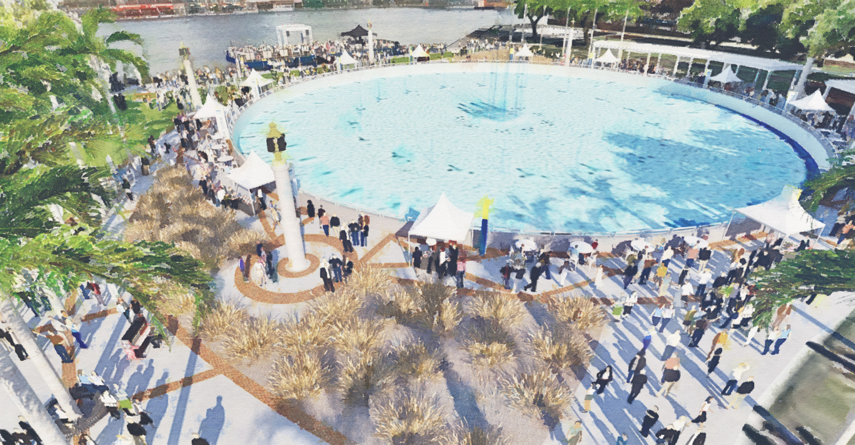
Let’s Make This Happen Together

